Slide 1
DAYANANDA SAGAR UNIVERSITY
SCHOOL OF ENGINEERING
Department of Computer Science and Technology
PARKINSON'S DISEASE DETECTION
Presented By:
TEJAAL M (ENG19CS0334)
VARSHA P(ENG19CS0353)

Slide 2


Slide 3
OVERVIEW
Abstract
Introduction
Flowchart
Block Diagram
Result and Analysis
Conclusion
References

Slide 4
ABSTRACT
Parkinson disease (PD) is a universal public health problem of massive measurement.
This generally results in breakdown of the neurons producing dopamine.
Qualitative speech starts to decline as the disease progresses and the variability in the vocal cord vibration (also known as fundamental frequency) starts to occur.
In this project we have used ‘TensorFlow’ deep learning library of python to implement our neural network for predicting the severity and Machine Learning Models linear regression, Logistic regression, Decision tree classifier, Support vector machine, Random forest classifier, Xgbooster.
The accuracy values obtained by our method are better as compared to the accuracy obtained in previous research work.

Slide 5
INTRODUCTION
With increase in the aging population, the people affected with neurological disorders are also increasing rapidly and thus, the need for quick and effective means for monitoring them becomes more and more important.
It has been noticed that in almost 90% of the cases, the people suffering from PD experience impairment of the vocal cords, which result in dysphonia.
According to the traditional sound measurement standards, jitter, shimmer, pitch, noise to harmonics ratio and pressure level of absolute sound have been used effectively.
In our project, we are aiming to apply the Machine learning classifiers in order to predict the status of health of the patients fusing acoustic analysis.

Slide 6
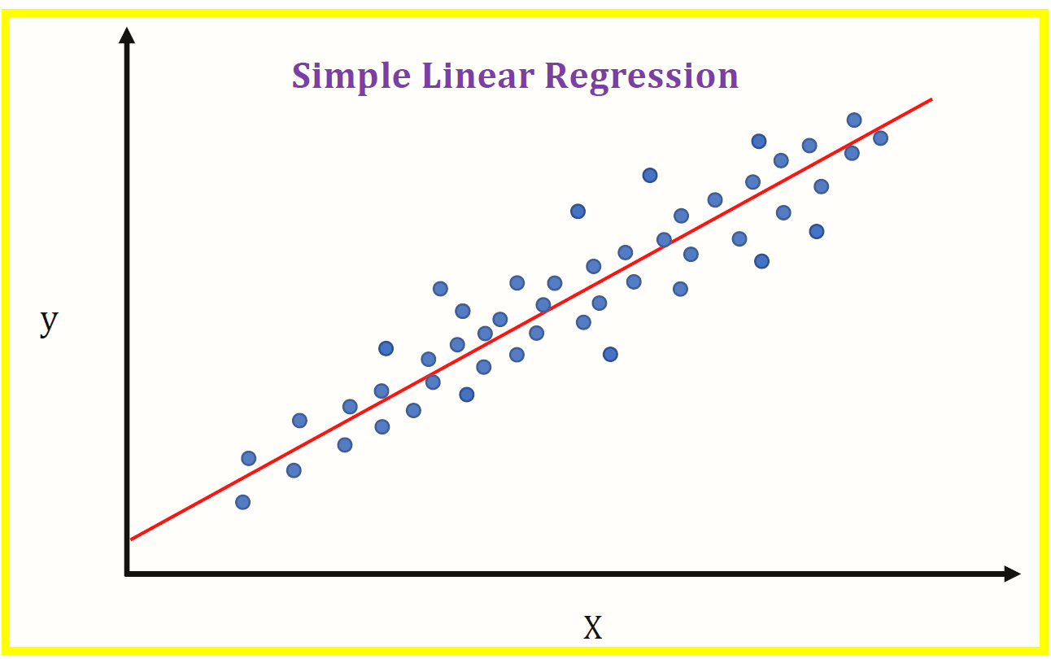
LINEAR REGRESSION
It is a statistical method that is used for predictive analysis.
Linear regression makes predictions for continuous/real or numeric variables. Since linear regression shows the linear relationship, which means it finds how the value of the dependent variable is changing according to the value of the independent variable.

Slide 7
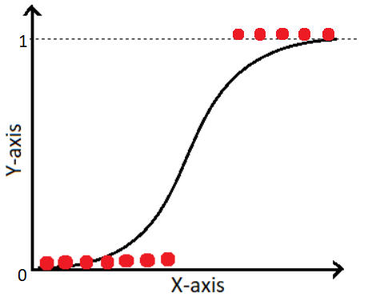
LOGISTIC REGRESSION
This classification occurs on the basis of a sigmoid function, known as the logistic function which takes in a real input and gives out a value in between 0 and 1.

Slide 8
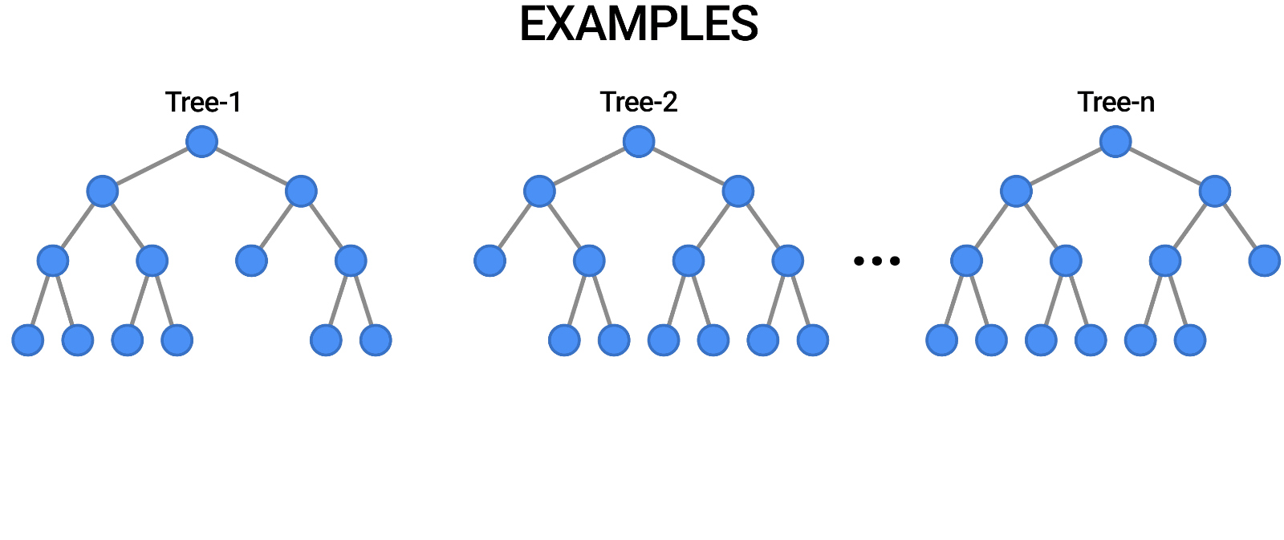
DECISION TREE CLASSIFIER
In case of Decision Tree classifier, the input is split into sub-spaces based upon certain functions. It helps in reaching a conclusion based upon conditional control statements

Slide 9
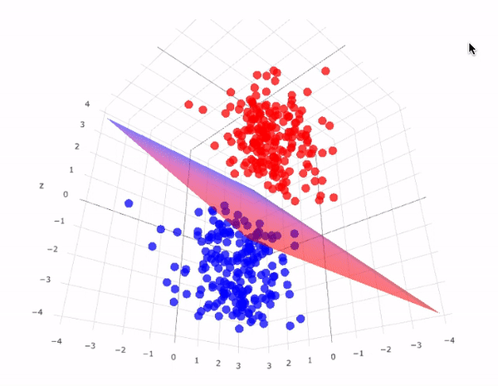
SUPPORT VECTOR MACHINES (SVM)
It is an algorithm for both linear and non-linear data.
It transforms the original data in a higher dimension, from where it can find a hyper plane for separation of the data using essential training tuples called support vectors.
A Support Vector Machine is a discriminative classifier formally defined by a separating hyper plane.

Slide 10
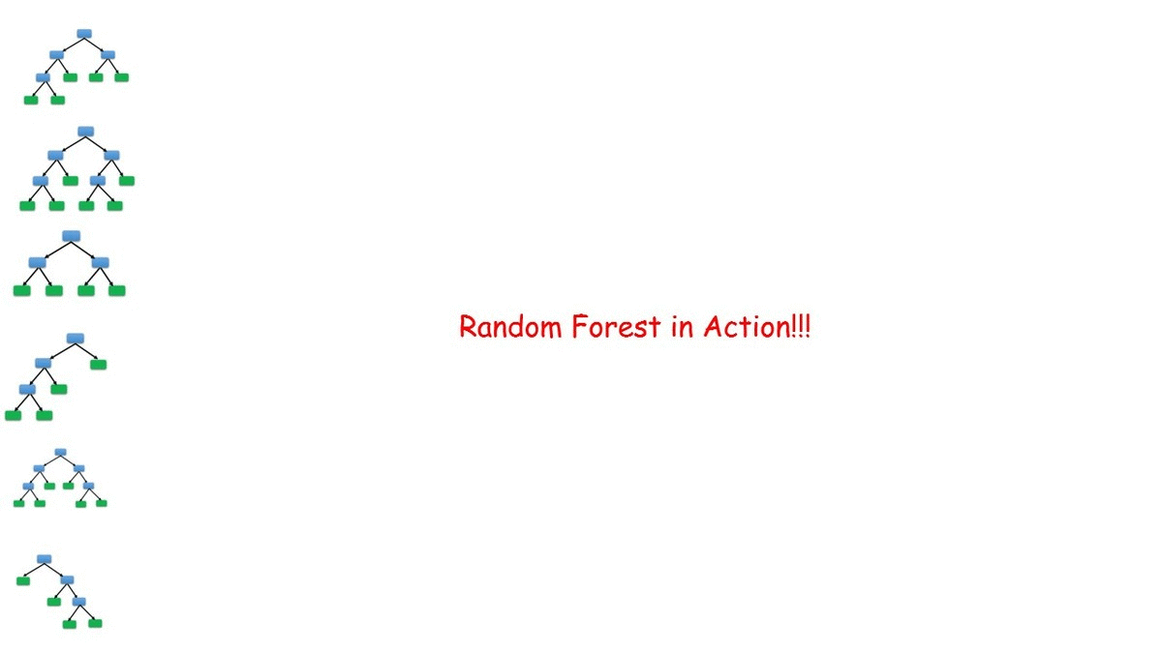
RANDOM FOREST CLASSIFIER
Random forest is an ensemble of decision trees based classifiers.

Slide 11

XGBOOSTER
Weights play an important role in XGBoost.These individual classifiers/predictors then ensemble to give a strong and more precise model.

Slide 12
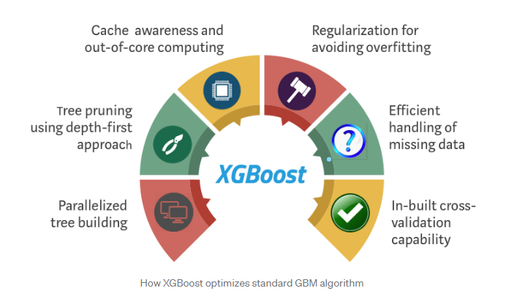
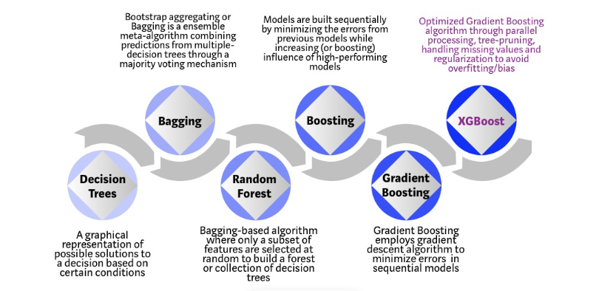
XGBOOSTER

Slide 13
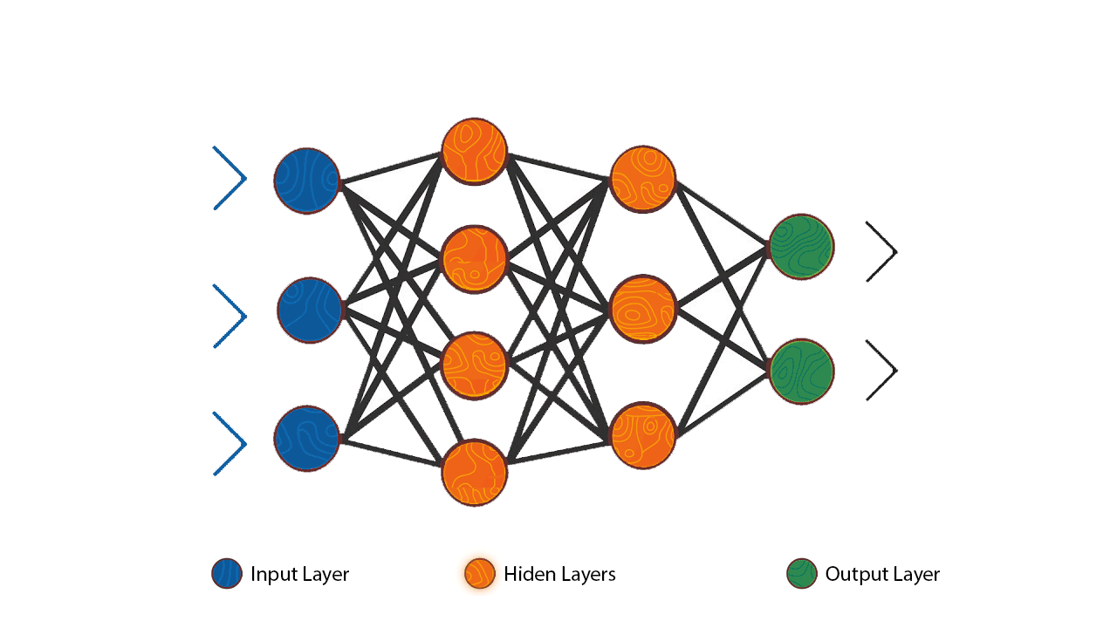
DEEP NEURAL NETWORK
Using Sequential API, here we create the model layer-by-layer. It is very simple and easy to use. But sharing of layers or branching of layers is not allowed and can’t have multiple inputs or outputs.

Slide 14
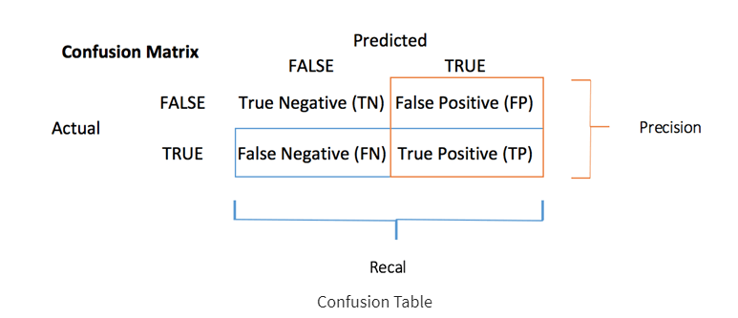
CONFUSION MATRIX
The confusion matrix visualizes the accuracy of a classifier by comparing the actual and predicted classes.

Slide 15


SCOPE
The main aim of this project is to predict if a person has Parkinson ‘s disease or not.
The objective of this project is to show high accuracy that could be achieved using different machine learning and deep learning models to detect Parkinson’s disease at an early stage.

Slide 16
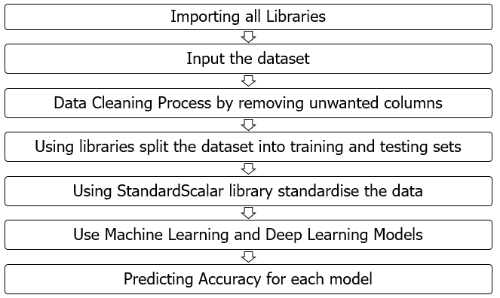
FLOWCHART

Slide 17
ARCHITECTURE
PD PRESENT
TRAIN DATA(80%)
TEST DATA(80%)
DATASET
DATA CLEANING
STANDARDISE DATA
ML/DNN MODEL
PREDICTED DATA
PD ABSENT

Slide 18
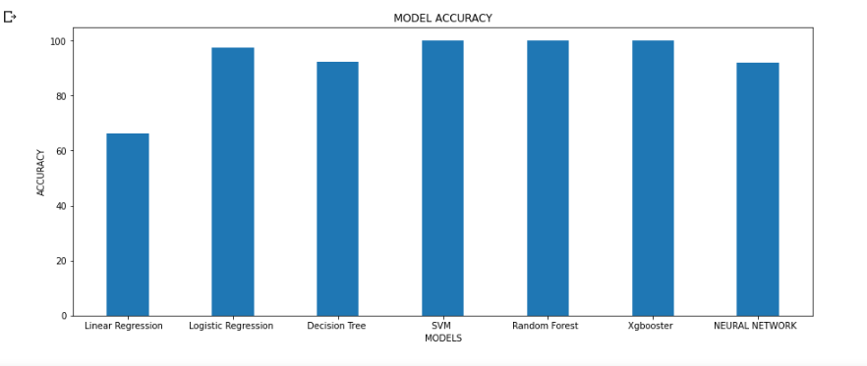
RESULT
The 3 machine learning models SVM,RANDOM FOREST CLASSIFIER and XGBOOSTER have achieved 100% accuracy, compared to other existing models.

Slide 19
ANALYSIS
MODELS | ACCURACY
LINEAR REGRESSION | 66.3%
LOGISTIC REGRESSION | 97.4%
DECISION TREE | 92.3%
SVM | 100%
RANDOM FOREST | 100%
XGBOOSTER | 100%
DNN | 92.3%

Slide 20
CONCLUSION
Hence we can see from the above accuracy checks that 3 machine learning models SVM,RANDOM FOREST CLASSIFIER and XGBOOSTER gives 100% accuracy. Therefore it could be used to predict Parkinson ‘s disease.
Although we have used a dataset of 197 instances, the accuracy of our approach can be further improved by implementing it on a larger dataset, having more number of instances of each class as well as on a combined database of patients’ voice data and other patient features.

Slide 21
REFERENCES
https://www.sciencedirect.com/science/article/pii/S1877050918308883/pdf?md5=1cb9104bcdc44ef930974ca00bfdfd5c&pid=1-s2.0-S1877050918308883-main.pdf
http://ijariie.com/AdminUploadPdf/EARLY_DETECTION_OF_PARKINSON_S_DISEASE_USING_MACHINE_LEARNING_ijariie11591.pdf
https://iopscience.iop.org/article/10.1088/1742-6596/1372/1/012041/pdf
https://citeseerx.ist.psu.edu/viewdoc/download?doi=10.1.1.735.5660&rep=rep1&type=pdf
https://www.kaggle.com/datasets/nidaguler/parkinsons-data-set?resource=download&select=parkinsons.data

Slide 22

THANK YOU

